Slide 1
TELCO CHURN DATA ANALYSIS w/ SAS
By: Eric Ye
Professor: Arkar Min
December 12, 2020
Advanced SAS
Metro College of Technology

Slide 2
Background
Telco Churn Dataset; relevant customer dataset
51047 observations
58 variables
CHURN – whether or not the customer has left

Slide 3
Study Framework: Y and X variables
9 variables selected
Y variable: Churn
X variables:
CATEGORICAL VARIABLES: IncomeGroup, Occupation, CreditRating, MaritalStatus
CONTINUOUS VARIABLES: MonthlyRevenue, MonthlyMinutes, TotalRecurringCharge, OverageMinutes, Handsets, BlockedCalls

Slide 4
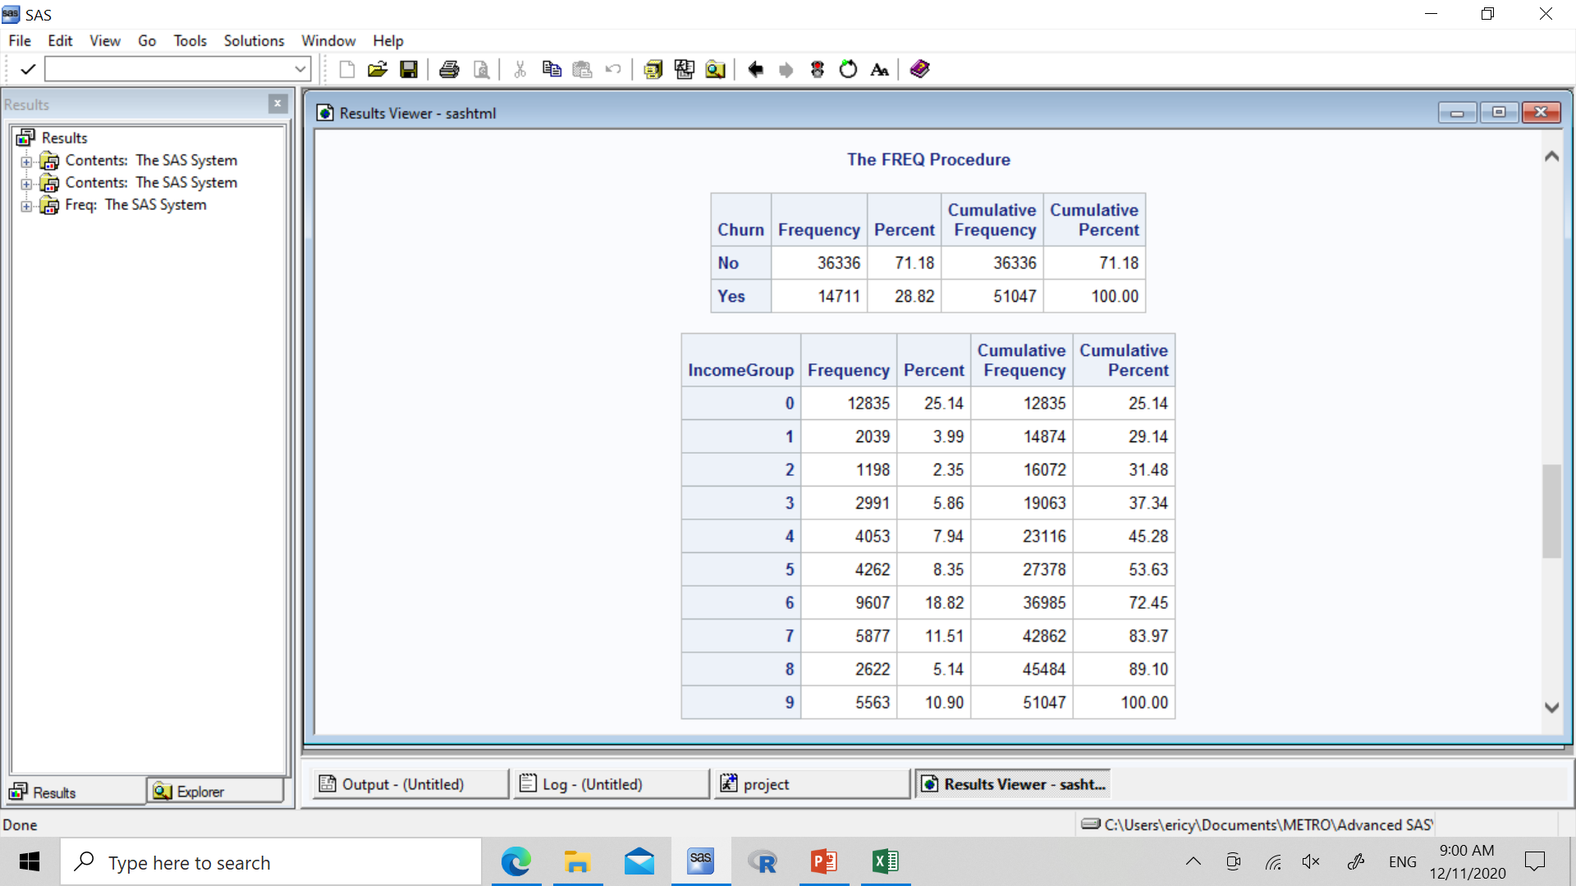
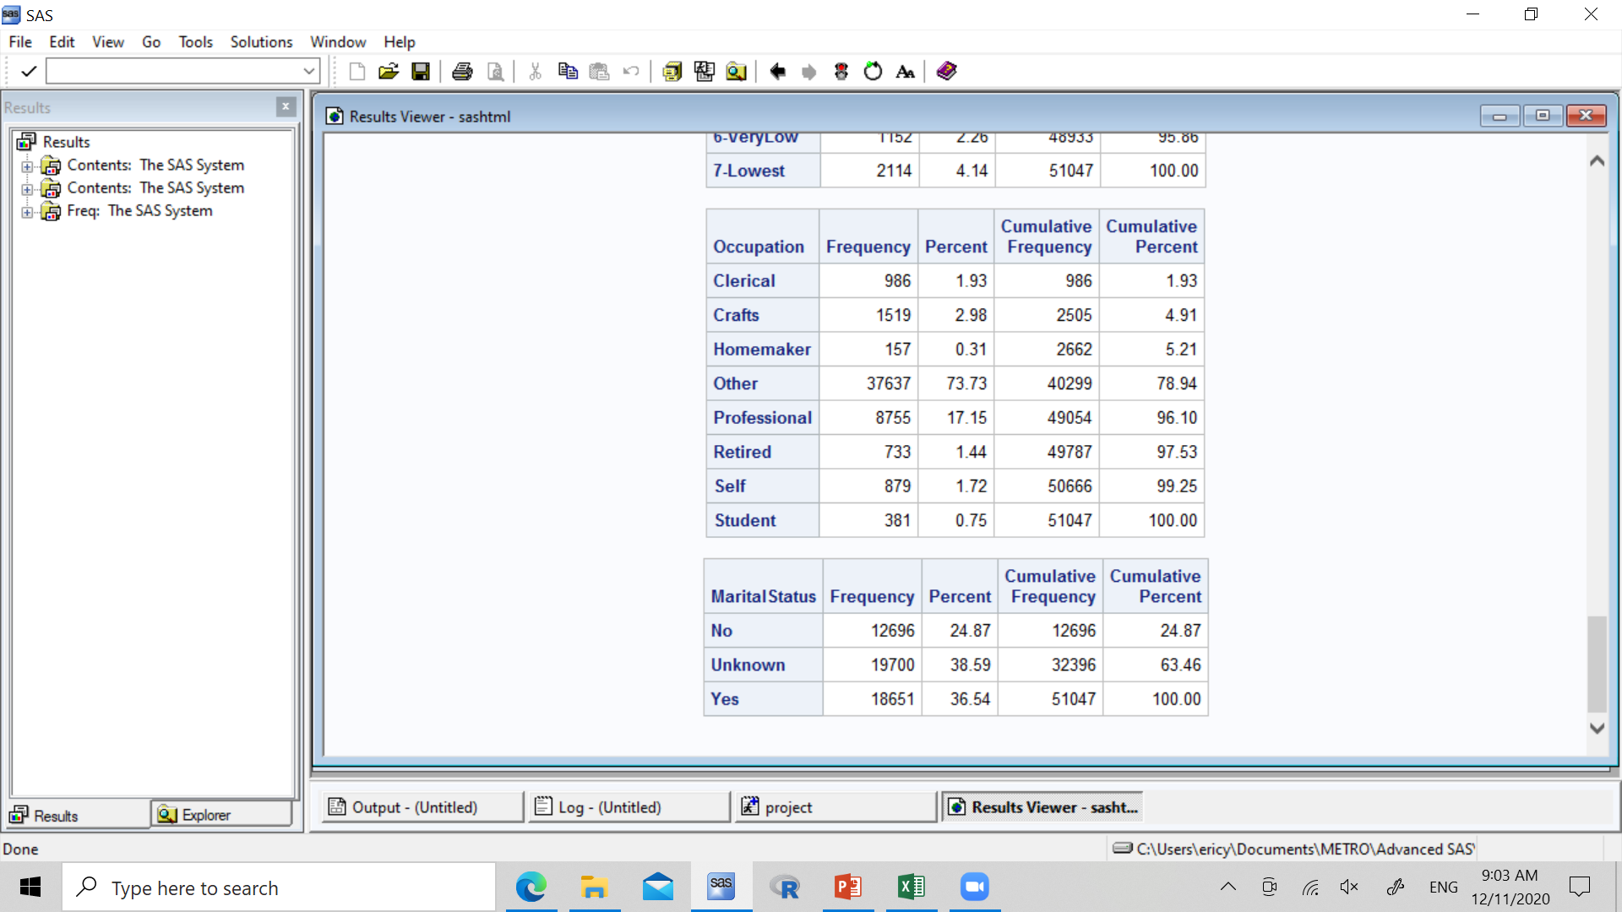
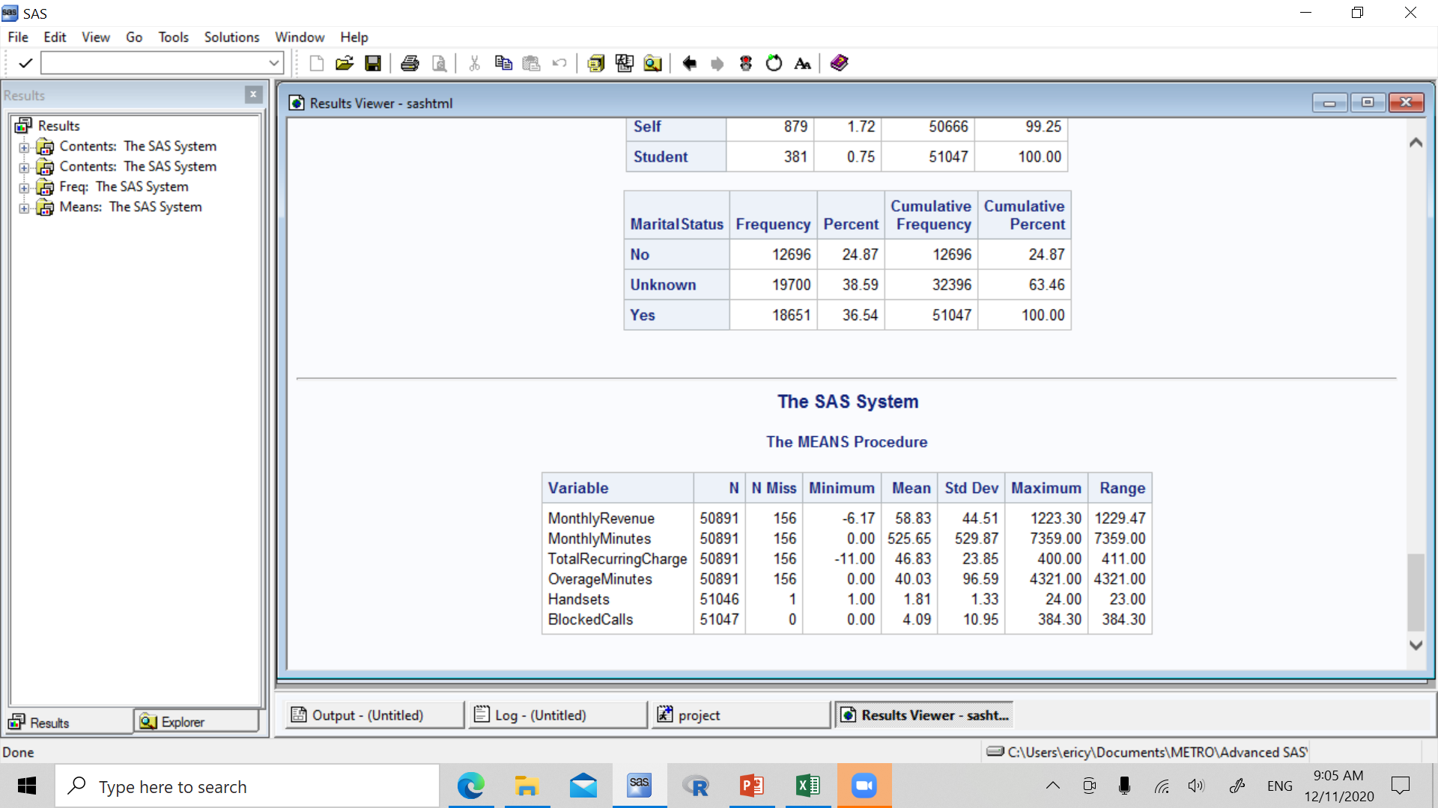
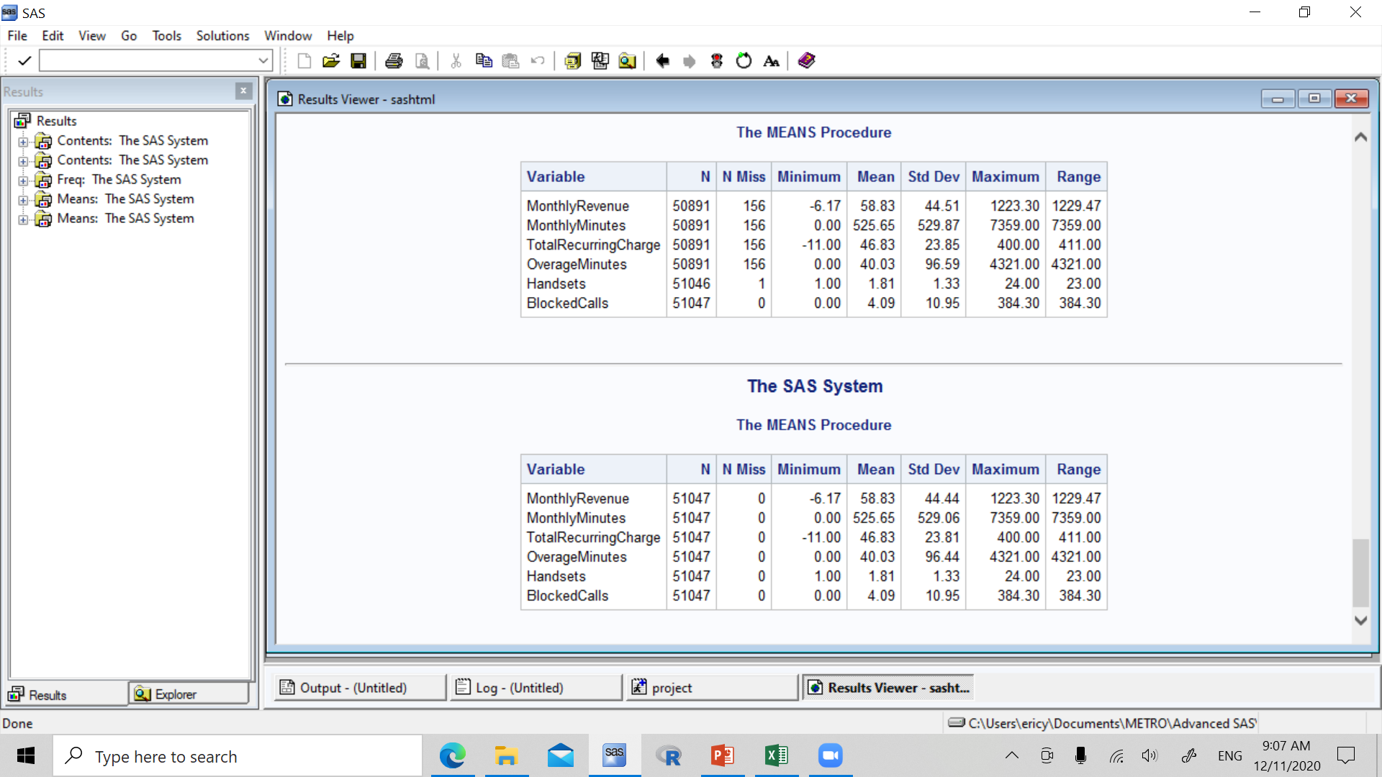
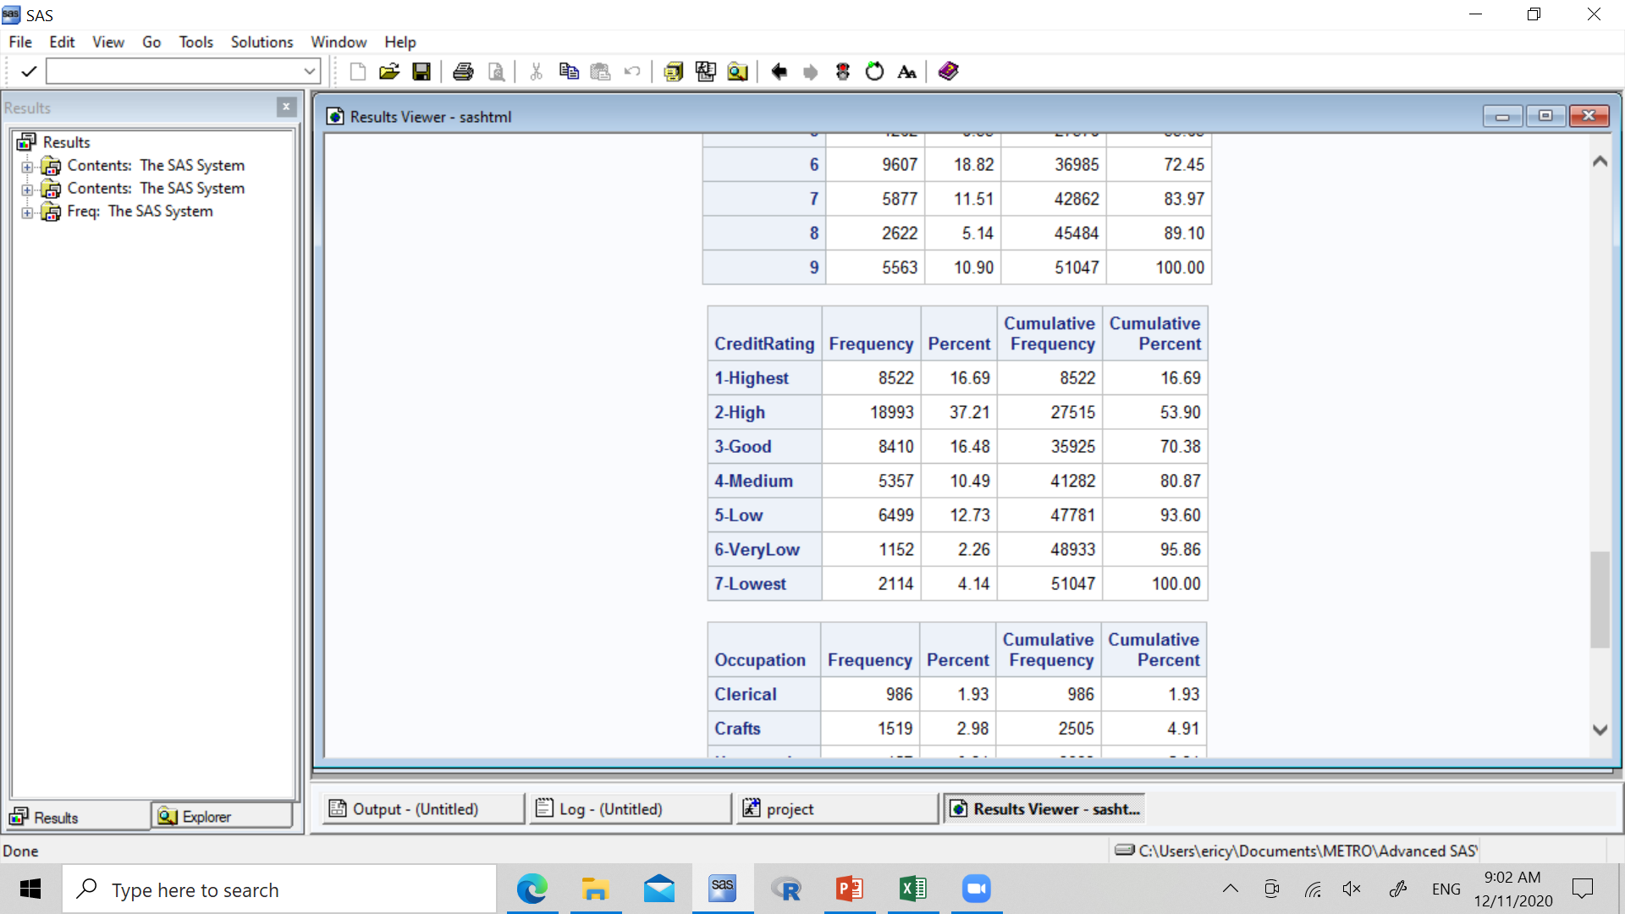
Data Validation: missing values

Slide 5
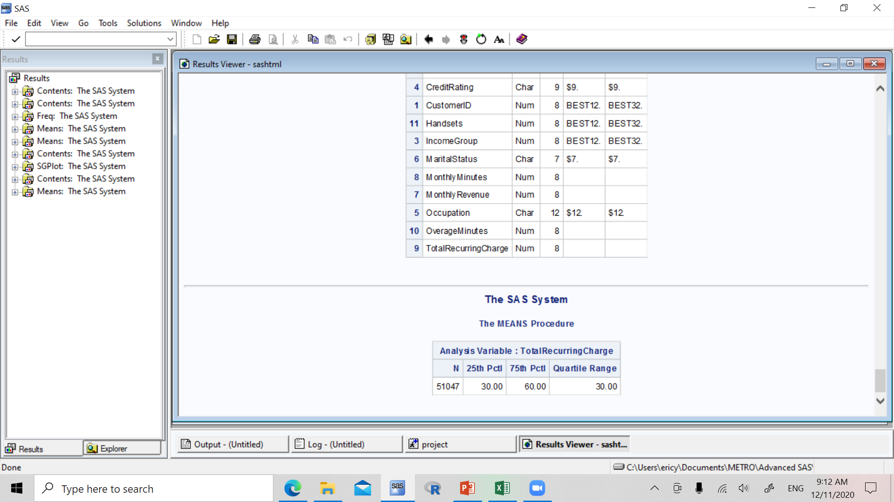
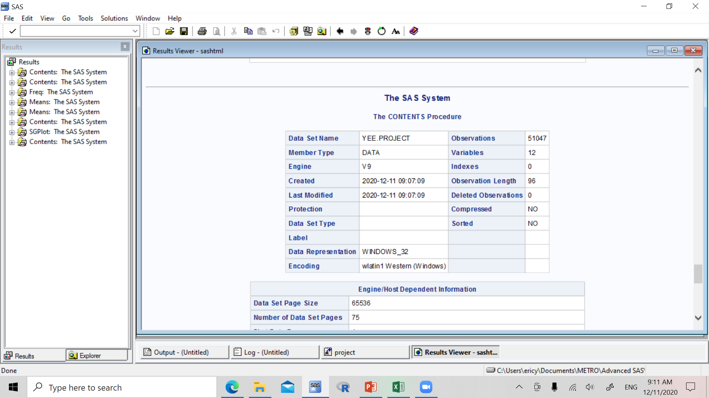
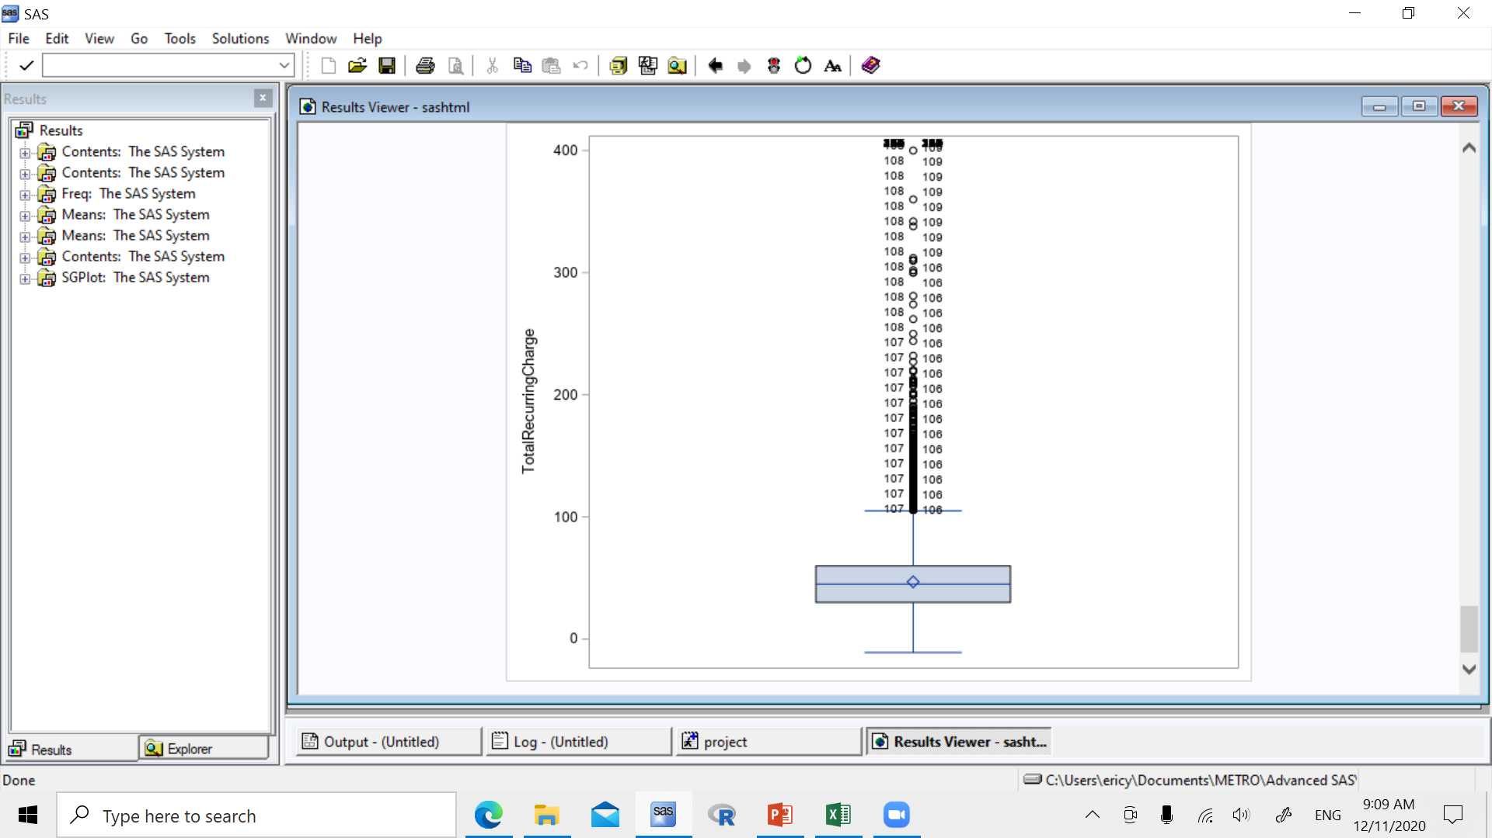
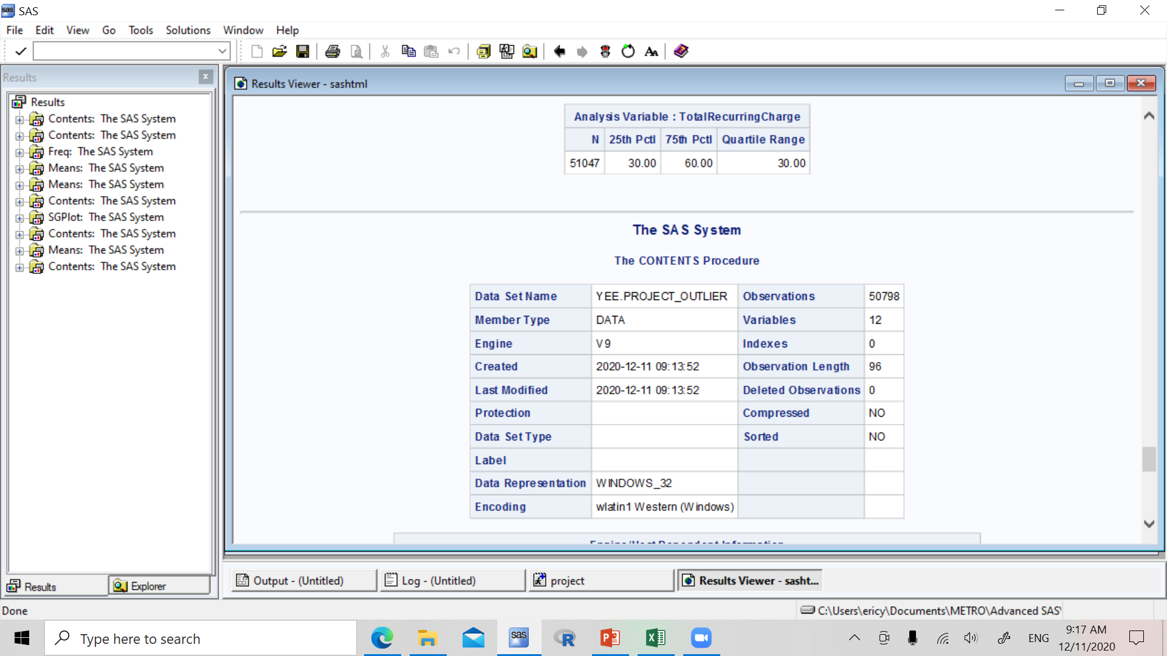
Data Validation: OUTLIERS

Slide 6
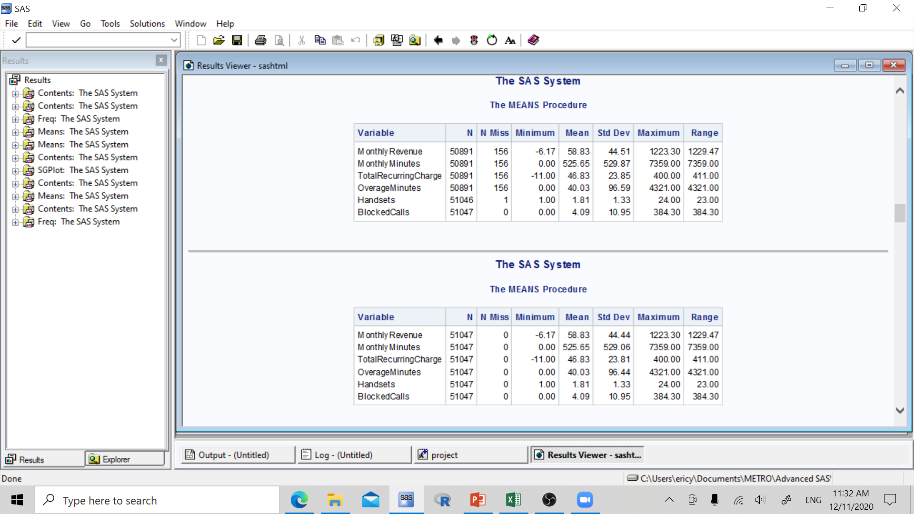
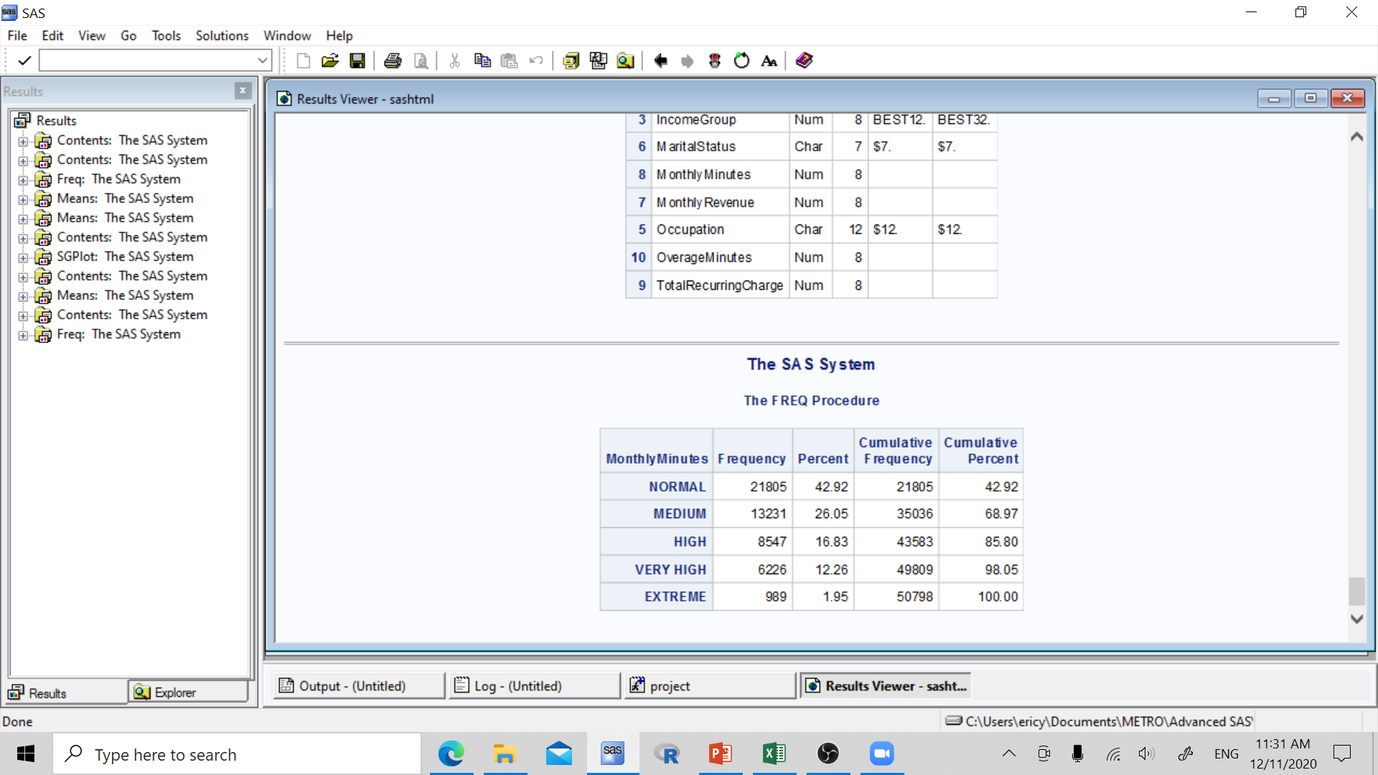
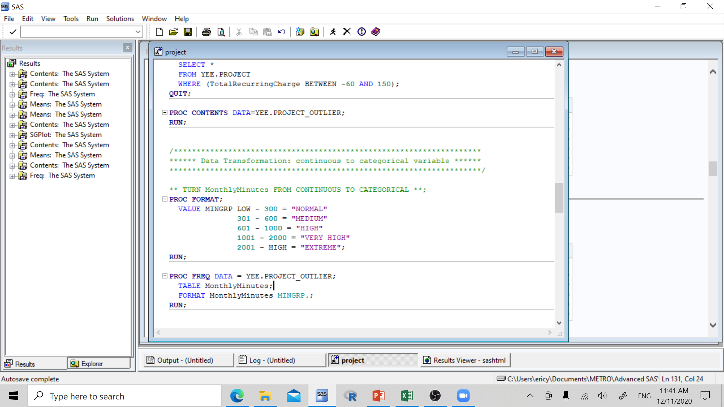
Data Transformation: continuous to categorical variable

Slide 7
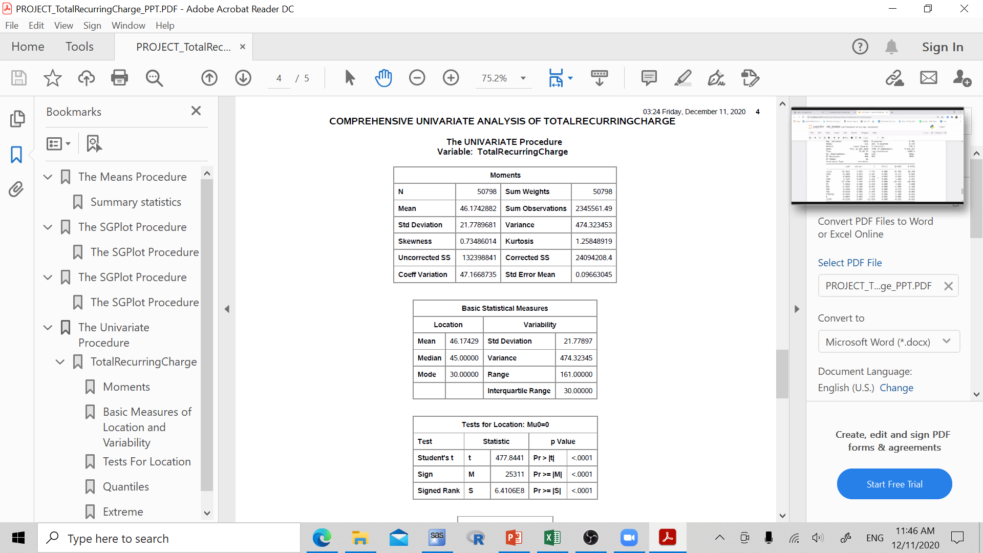
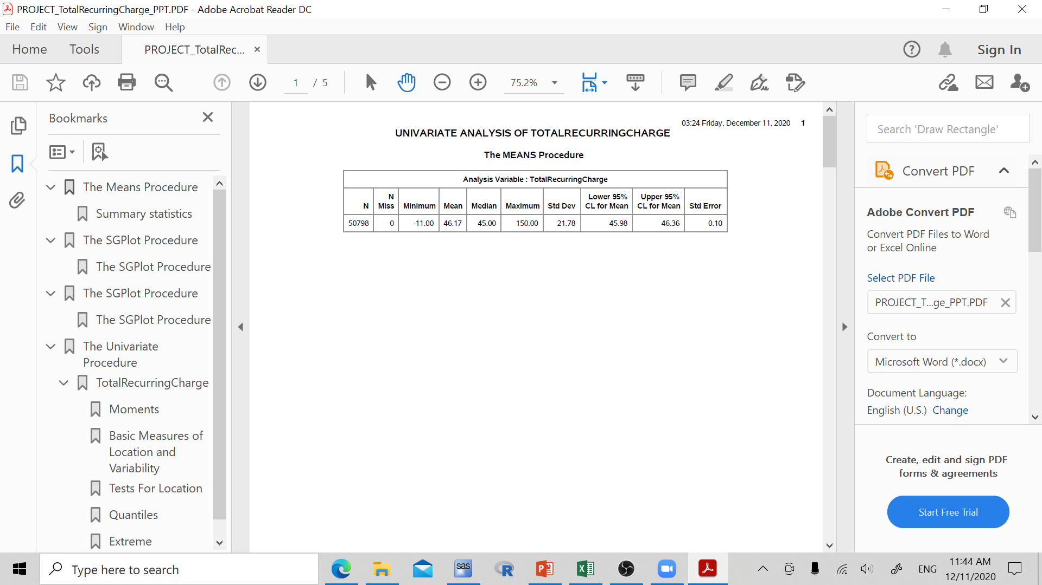
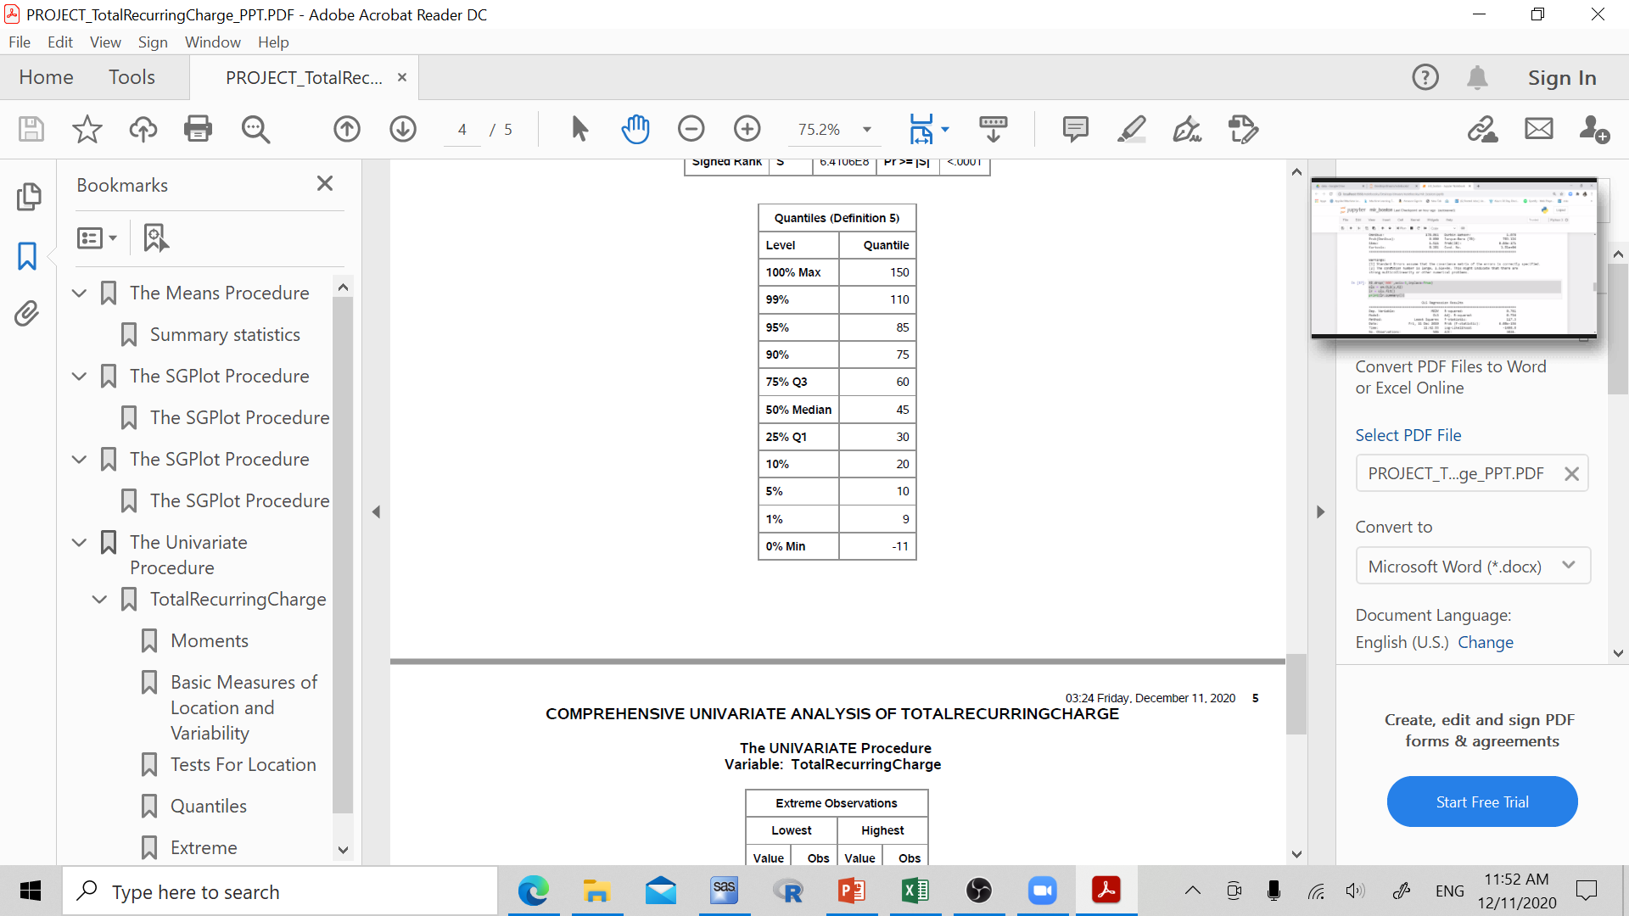
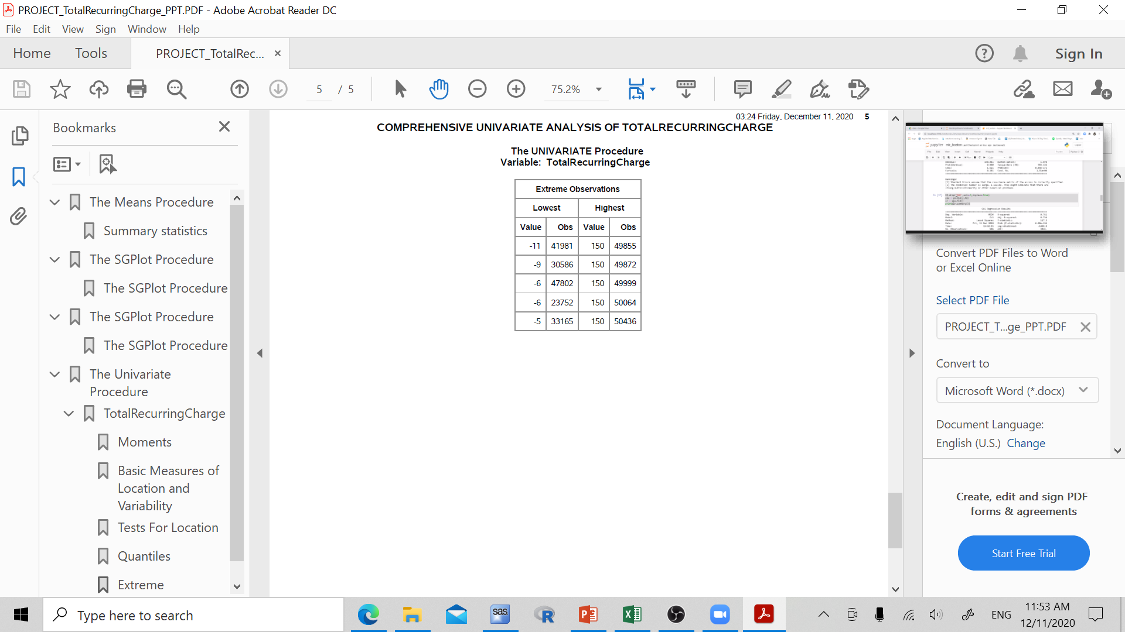
Univariate Analysis

Slide 8
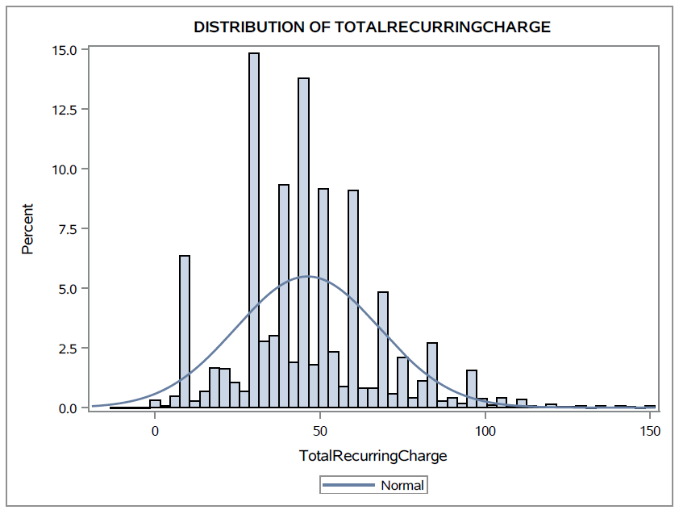
Univariate Analysis

Slide 9
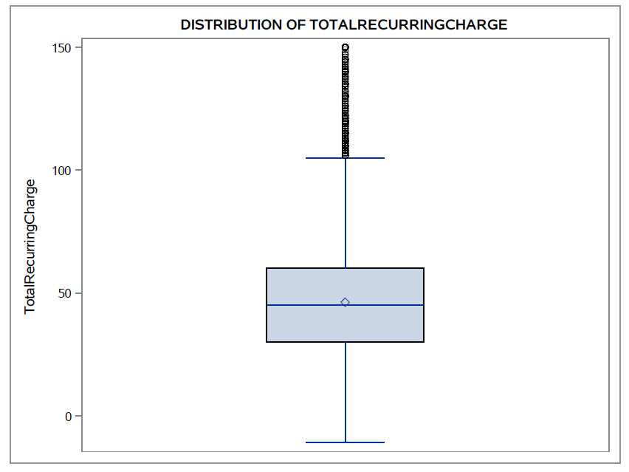
Univariate Analysis

Slide 10
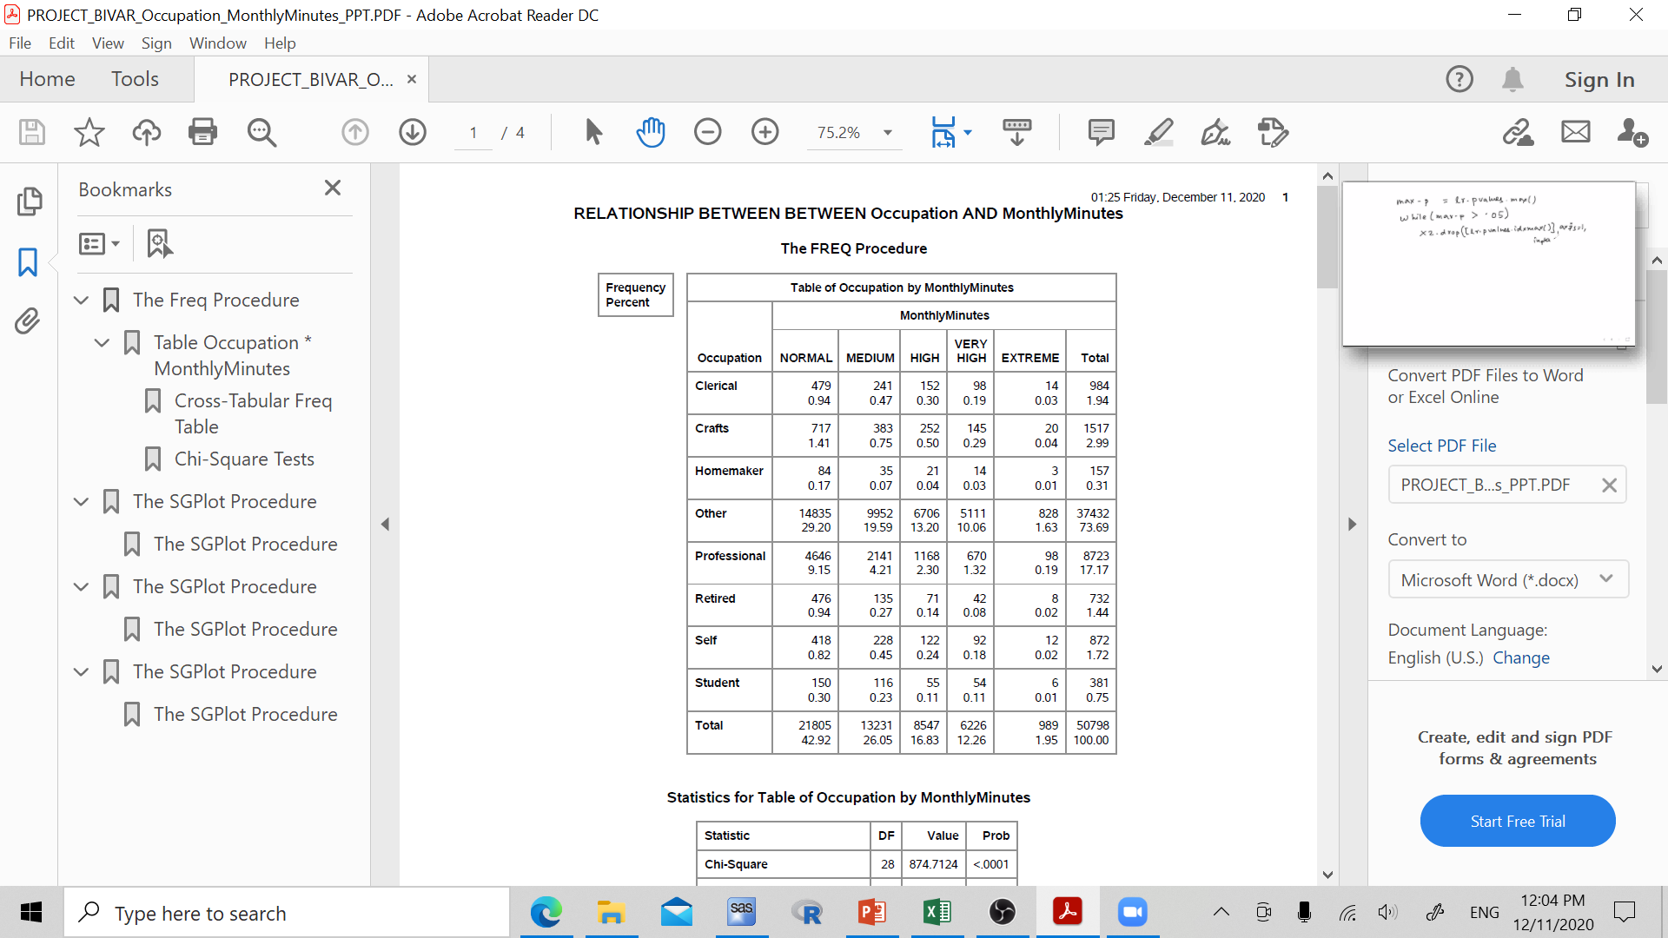
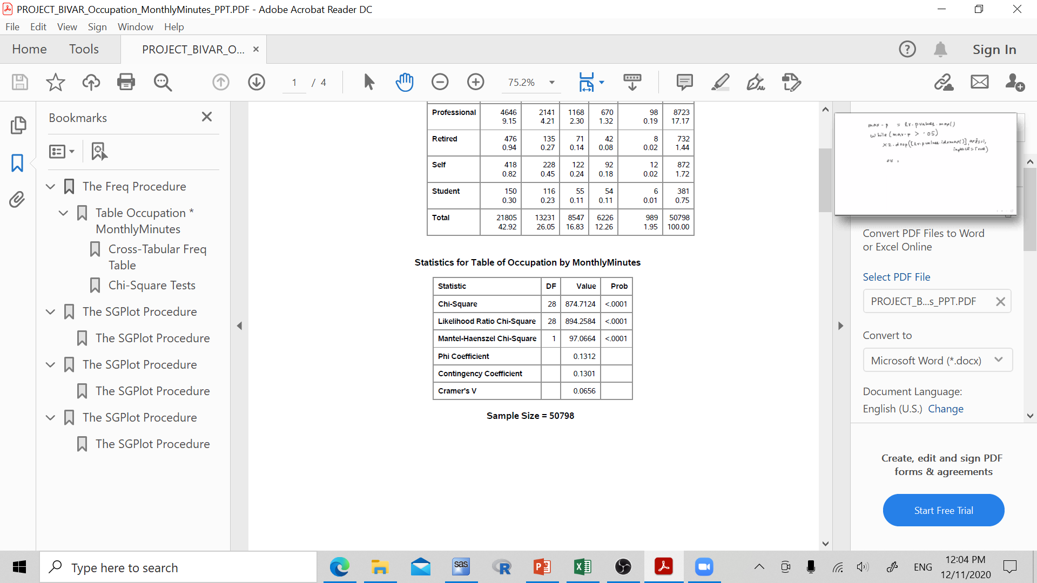
Bivariate Descriptive Analysis

Slide 11
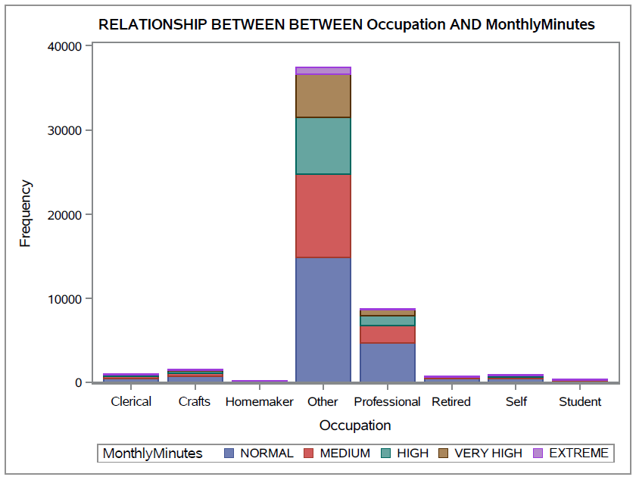
Bivariate Descriptive Analysis

Slide 12
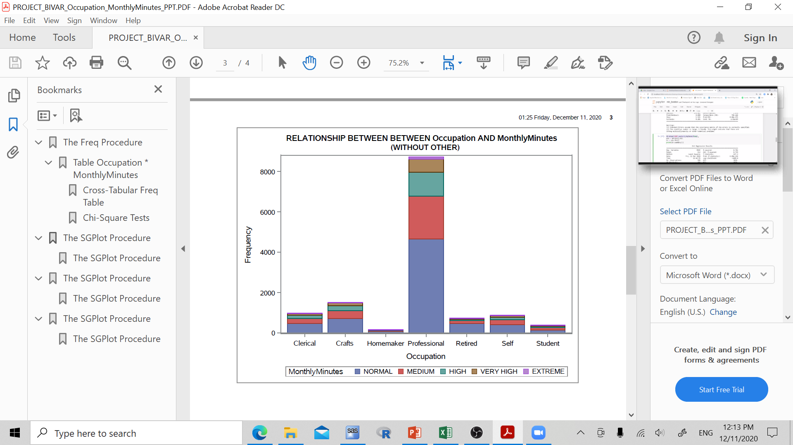
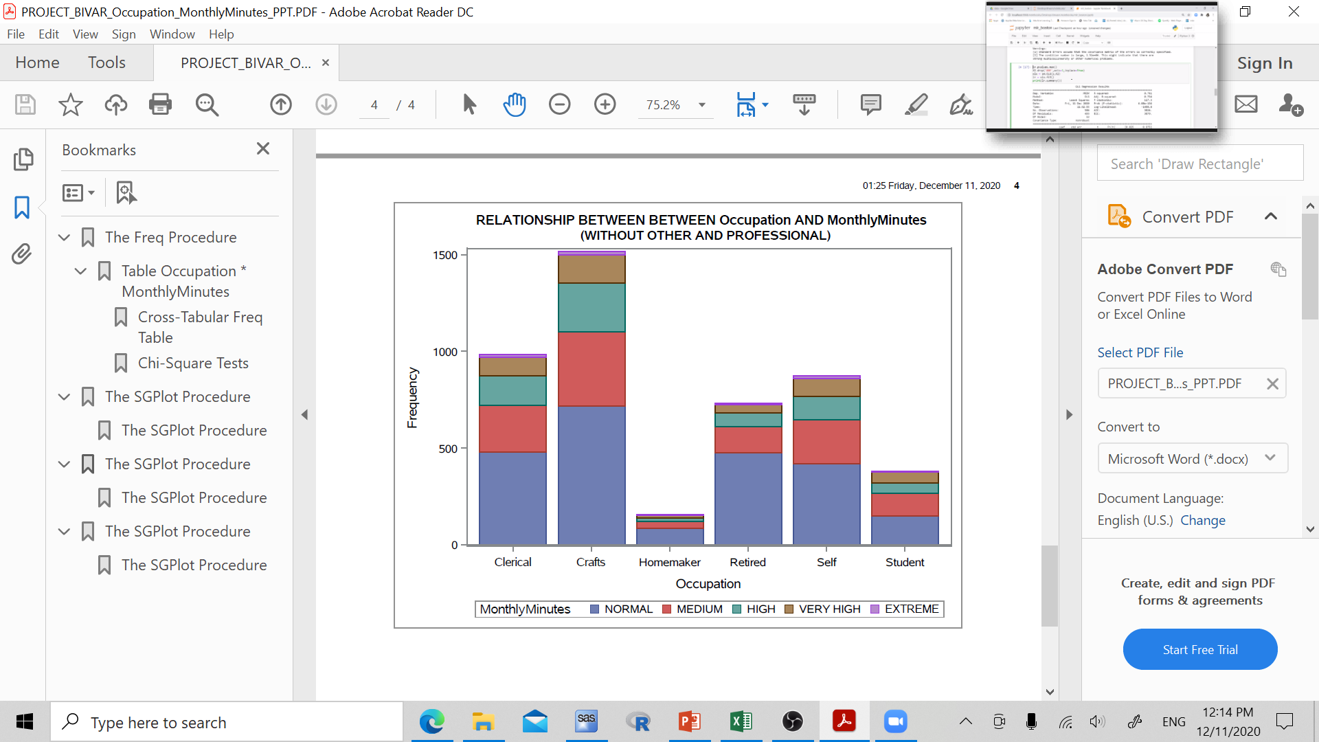
Bivariate Descriptive Analysis

Slide 13
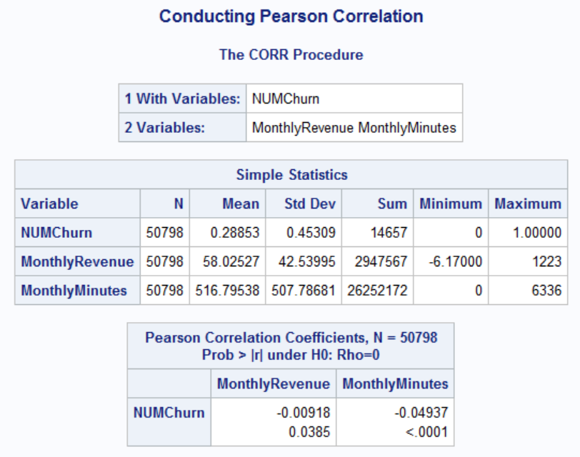
Hypothesis testing
H0: No association
Ha: Relationship
P<0.05 → reject null

Slide 14
THANKS FOR Listening!
Questions?

